Slide 1
SDR Individual Project
Connor Jenkins

Slide 2
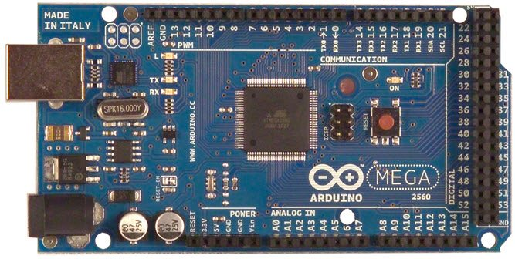
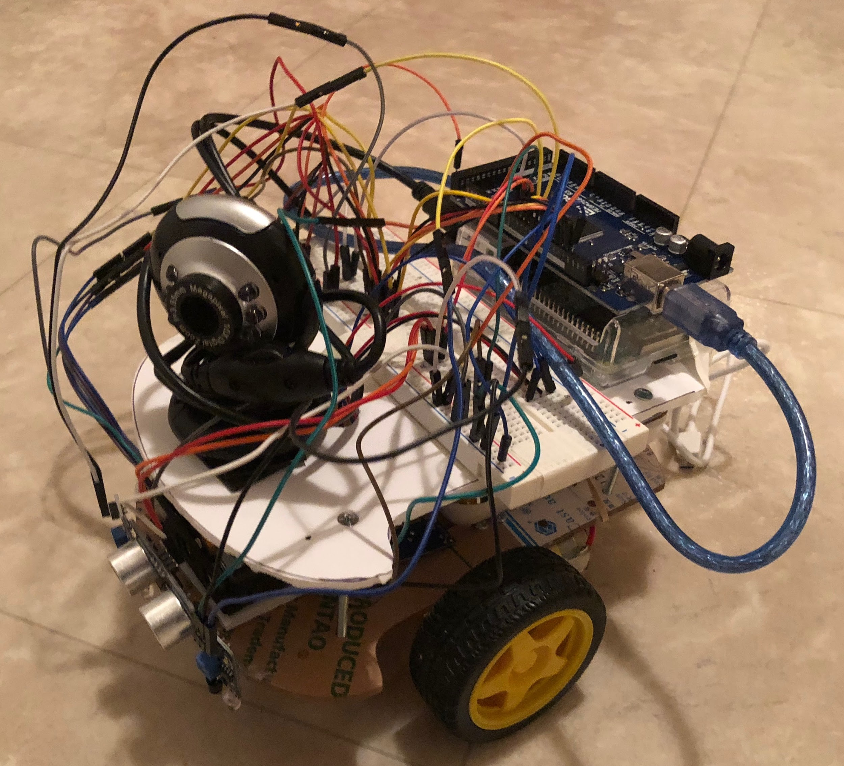
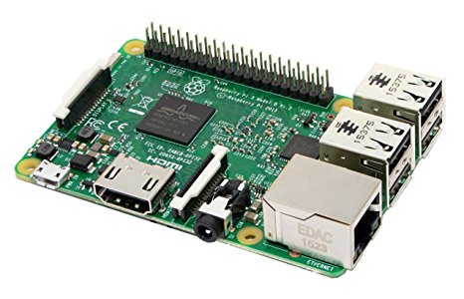
Description:
Small scale autonomous mobile robot (mini self-driving car) with following features:
Manual remote control
Live streaming video
Speed information
Odometer information
Obstacle detection and subsequent stop
Line detection for automatic driving
Objective:
The aim of this project is to configure relevant hardware components so that they can be used together effectively, and then implement the above software features in a project using the Arduino IDE, resulting in a basic autonomous mobile robot.
Approach:
Use Arduino Mega 2560 and Raspberry Pi 3 configuration to control the vehicle components
Use sonar for obstacle detection, infrared sensors for line detection, and motor controller + DC motors for wheel movement
Develop manual control protocol as well as self-driving algorithm for execution on the Arduino board
Test its operability on a track with lanes defined by black electrical tape
Milestones:
Hardware (3/7/18):
Build chassis to hold the Raspberry Pi, Arduino board, motors, wheels, breadboard, etc.
Correctly wire all of the components and give a power source
Software (ongoing):
Install OS and dependencies on Raspberry Pi
Build basic foundation of the driving system in Arduino IDE
Define protocol for manual driving control
Develop auto-driving algorithm
Presentation (4/4/18):
Demonstration
Quad-Chart

